Slide 1
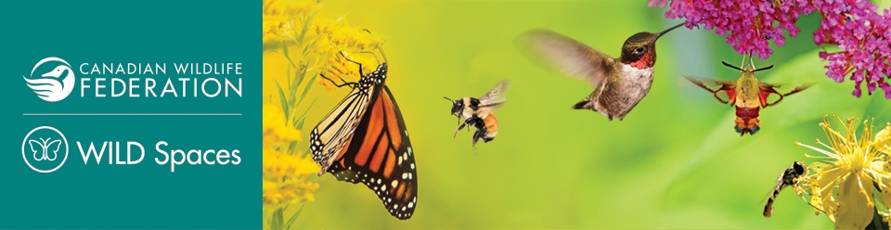
Holiday Winter Bird Activities

Slide 2
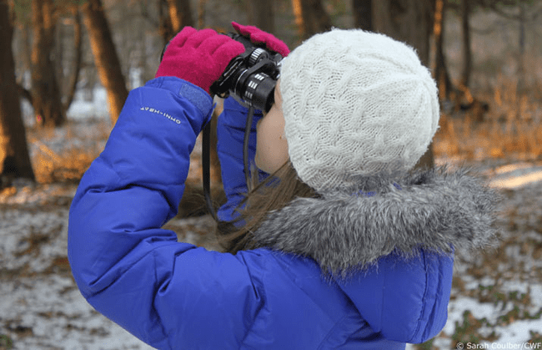
What's Ahead!
Play the game “Birds of Canada”​
Learn about the birds in our area​
Understand the purpose for the bird count​
Make a Holiday gift package for your family​

Slide 3
What are Winter Bird Counts
Everyday citizens who are enthusiastic about birds participate in some scientific data gathering. In Canada, there are two bird counts:
A) The Christmas Bird Count (CBC)
B) The Great Backyard Bird Count (GBBC)
A) Christmas Bird Count
The CBC started way back in 1900 by Frank Chapman, a renowned ornithologist who worked with the American Museum of Natural History. Due to the declining bird population and Frank’s interest in supporting our feathered friends, he initiated the Christmas Bird Count

Slide 4
What are Winter Bird Counts
The goal of the bird count activity was to replace a hunting competition called “Side Hunt” where people participated to kill the most birds and other animals through a competition. The aim was to replace this activity with a conservation-based activity.
B. Great Backyard Bird Count
The Great Backyard Bird Count takes place for four days in February.
First and foremost, the count has shifted interest in birding activity from hunting to a conservation-oriented activity.

Slide 5
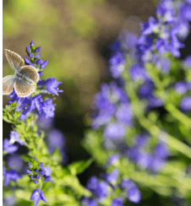
Bird Game Instructions
Goal: The goal of the game is to recognize Canadian birds.
Which of these are the common birds in Canada?
Stand up for birds. Sit down for non-birds (The teacher could also use “Thumbs Up and Thumbs Down”)
Use the next slide to play this game

Slide 6
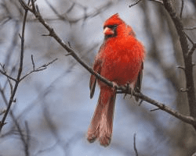
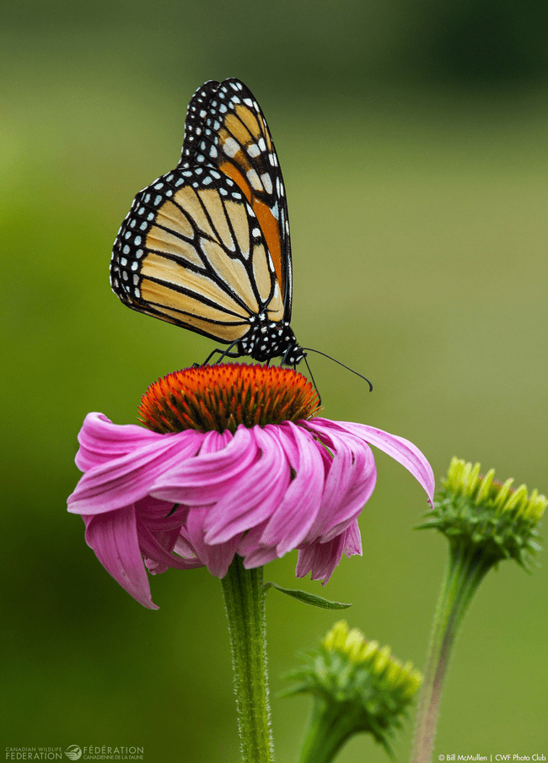
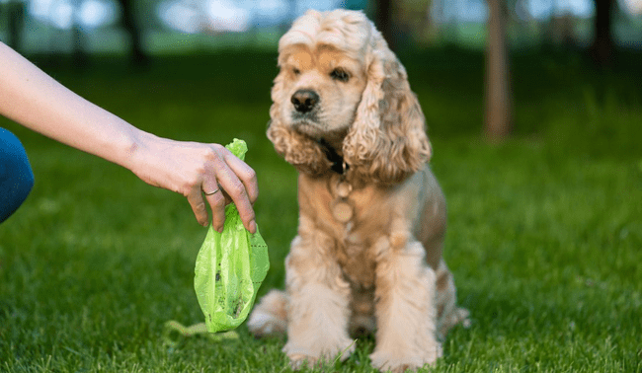
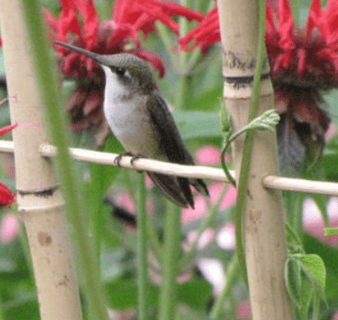
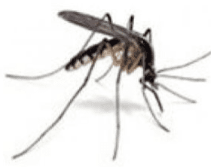
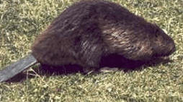
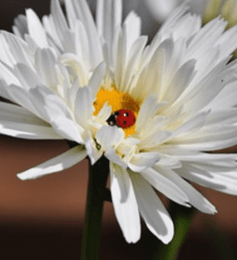
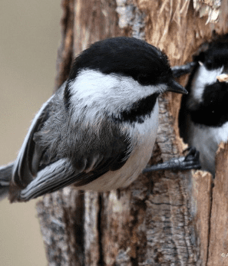
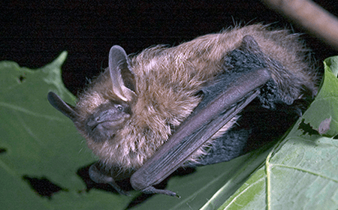
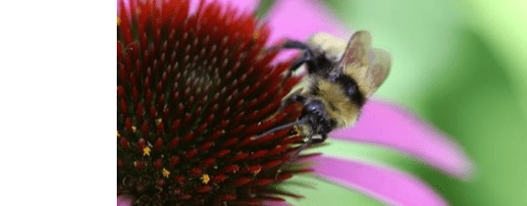
Bird Game

Slide 7

What Birds do You See During Winter?
With your classmates think, pair and share, the names of common winter birds in Canada
Think, Pair, Share

Slide 8
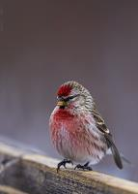
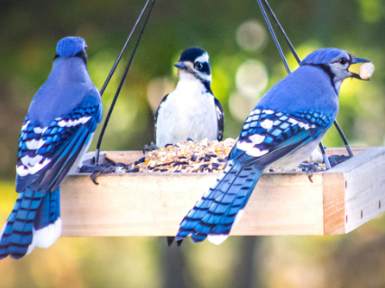
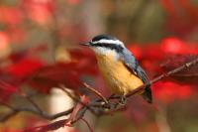
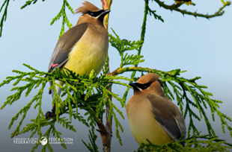
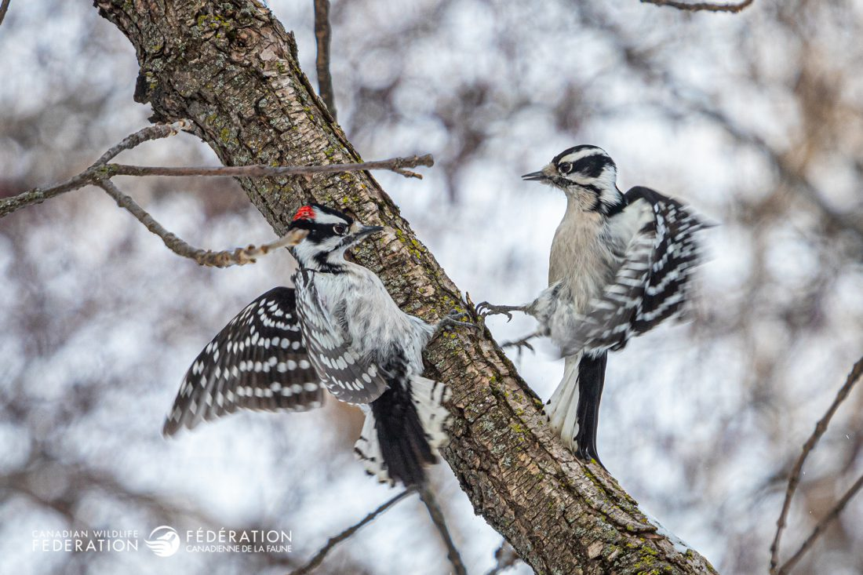

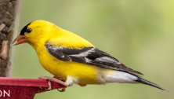
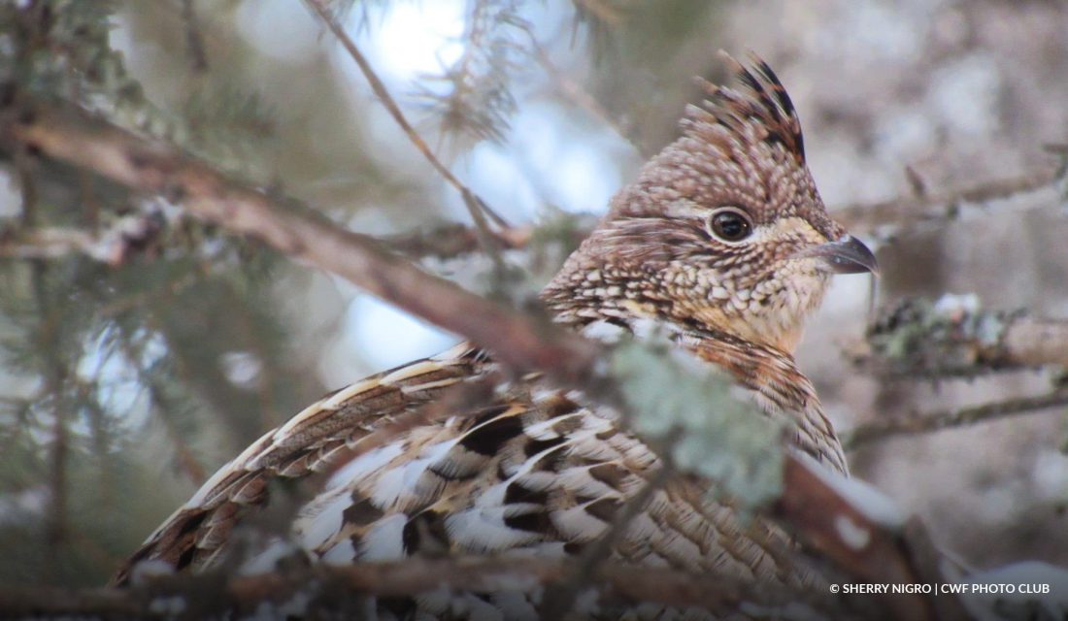
Common Winter Birds in Canada
Nuthatch
Blue Jay
Redpoll
Cedar Waxwing
American Goldfinch
Downy Woodpecker
Northern Cardinal
Ruffed Grouse

Slide 9
Bird Count Activity Explanation
Take an excursion outside to count the birds in the area they have designated
Work in teams of three for the count There will be two spotters and one student to tally the count. You can change tasks so that everyone has an opportunity to spot birds and to tally!
Estimate the number of winter birds you think you'll see in an hour of observation
Use the sheet for counting
There is a column to indicate your guess

Slide 10

Winter Bird Count
Christmas Bird Count” https://www.youtube.com/watch?v=8jeYGvWTH1k ​

Slide 11
Bird Counting time!
Now it is time to go outside and count the number of the different types of birds!
Remember! You will be working in groups of three
Two spotters
One student to tally the count

Slide 12

Bird Count Activity: Take a Guess
Bird | Estimate | Count
Northern Cardinal
Blue jay
American Goldfinch
Chickadee
Nuthatch
Ruffed Grouse
Cedar Waxwing
Redpoll
Downy Woodpecker

Slide 13
DISCUSSION
How can we support the birds in our area that stay here all winter? How will I know what to feed each type of bird?
Is the bird population increasing or decreasing? How would we find out?
Do birds live in a community, or do they live alone? What did we see during our Bird Count Excursion?
How can we make sure our birds have enough habitat to survive?

Slide 14
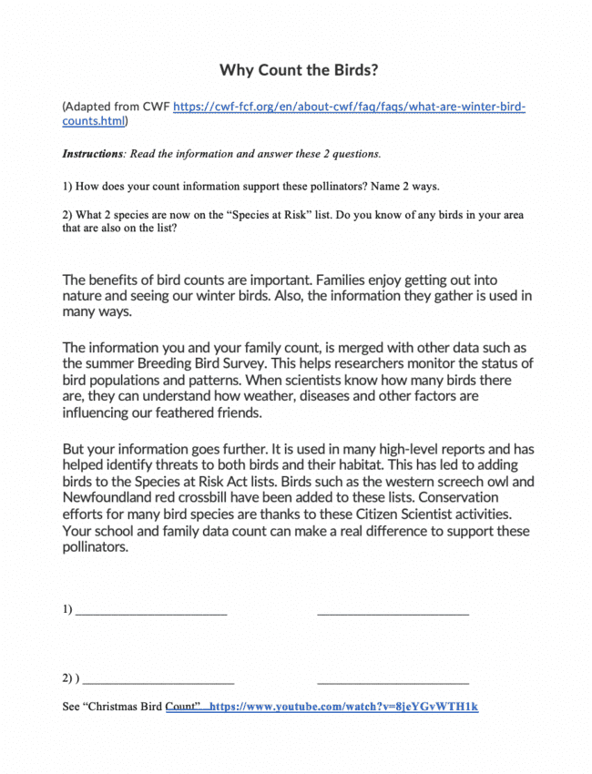
After: Why Count the Birds?
How does your count information support birds? Name two ways.
2Using the Government of Canada’s species at risk public registry, list two species of birds in your area that are now on the “Species at Risk” list.
Species search - Species at risk registry (canada.ca)

Slide 15
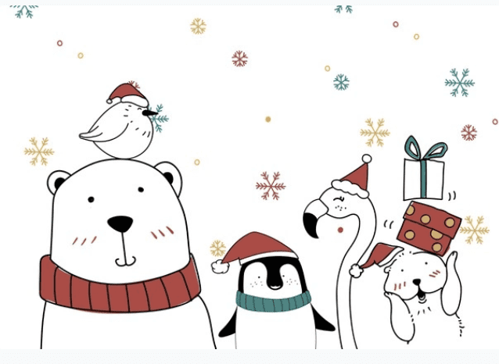
Designing a Holiday Card
Goal: To create a holiday card and information package to explain the Holiday Season Bird count.
Instructions: ​
You have made a bird counting invitation package for your family members. In it is all the information you need to go on a bird counting adventure. You will select the location and time with your family members.

Slide 16

Holiday Card Checklist
Use this checklist to make sure you have included all of the sections of the card so your family members can count the birds successfully.
List of Items | My Rating
Decorative Card with Holiday Theme | 1 2 3 4
Information about “Counting Birds” “Winter Birds of Canada” sheet “Tally for Bird Counting” sheet to count birds “Why Count Birds” information sheet | 1 2 3 4

Slide 17

For more information, please follow this link to the WILD Spaces online classroom

