Slide 1

My Garden: Fall and Winter

Slide 2
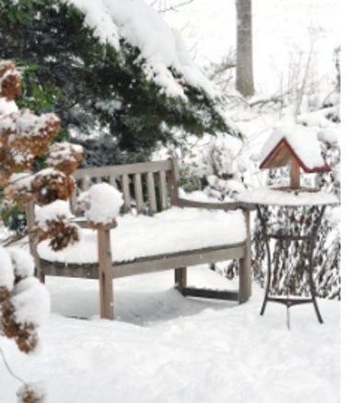
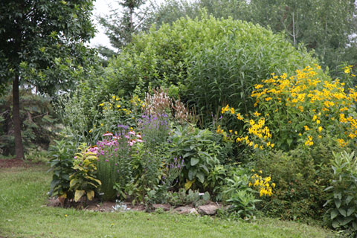
What's Ahead!
How do I get ready for fall and winter?
Play a game called “Fall Garden Project”​
Make a pledge

Slide 3
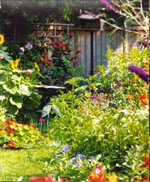
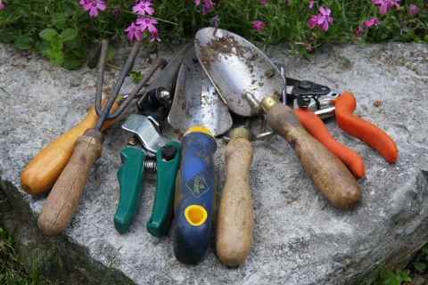
Welcome back!
It is good to be back from the summer break
How has your garden evolved?
Did you know that gardening can be done year-round?
Whether its Fall, Winter, Spring or Summer, there's always something to do in your garden! For example: Take your hoses in for the winter!
How do we Help Our Gardens During Winter? Part I ​

Slide 4
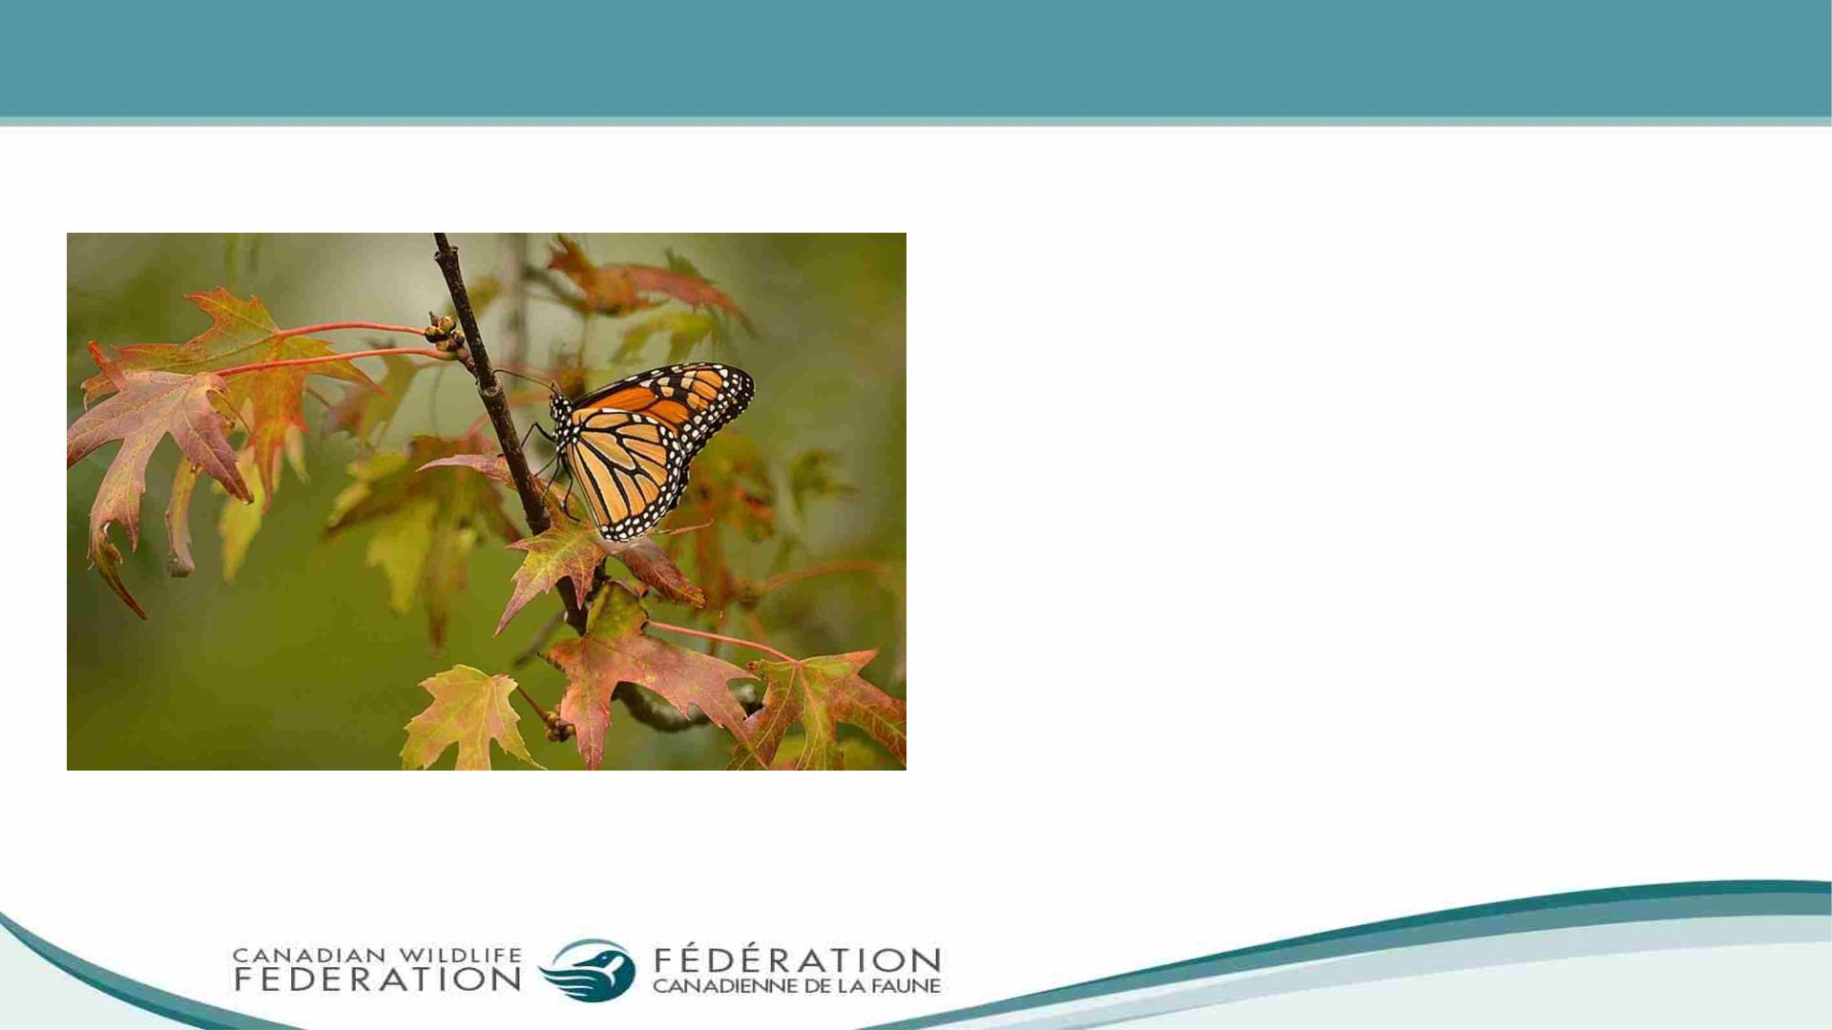
Why Should We Care for our Garden in Fall and Winter?
• We create shelter for overwintering
pollinators at different stages of
development
• Set pollinators up to thrive next spring
and summer
• When you allow the leaves in your
garden to breakdown, the leaves help
preserve soil moisture, return nutrients
into the soil and suppress weed

Slide 5

Annuals vs Perennials
• Before we get into how to prepare our
gardens for the colder months, let us reflect
on some of the plant categories:
o Annuals are plants that live for one
warm season but will not survive the
harsh winter
o Perennials, on the other hand, persist
from season to season and with the
right care can be a joy for years to come

Slide 6

How do we Care for our Garden During Fall?
Here are a few tasks for early to mid fall:
• Prepare your garden beds for next spring by
adding on compost and mulch
• Empty and cover your rain barrels before
the temperature drops below freezing
• If your school garden has trees and shrubs,
let the leaves remain on the ground below
the tree. Rake back any leaves that spread
too far
• Water the leaves down a bit to help it stay
in place

Slide 7

How do we Care for our Garden During Fall?
• If you’re experiencing a dry autumn, water any young trees.
On a warm day, drain and smoothly coil your hoses and take
them inside
• Consider growing native goldenrods and asters. They are
some hardy perennials that still blooms in the fall!
• Note that while some species of goldenrod do spread
quickly, some do not and are lovely additions even to small
gardens. Research suggests that none are responsible for
hay fever as its pollen is too heavy to travel
• Please follow this link for more information: Canadian
Wildlife Federation: Early to Mid Fall (cwf-fcf.org)

Slide 8

How do we Care for our Garden During Fall?
Here are a few tasks for late fall into winter
• Compost leaf and yard waste that is disease-free
• If you’ve dug in new plants this autumn, mark
their spot to help remember where not to dig in
the spring
• Collect seeds from your plants for planting in the
spring
• Conduct a soil test to see what’s needed in your
garden
• Clean your garden tools and store them for the
next season

Slide 9
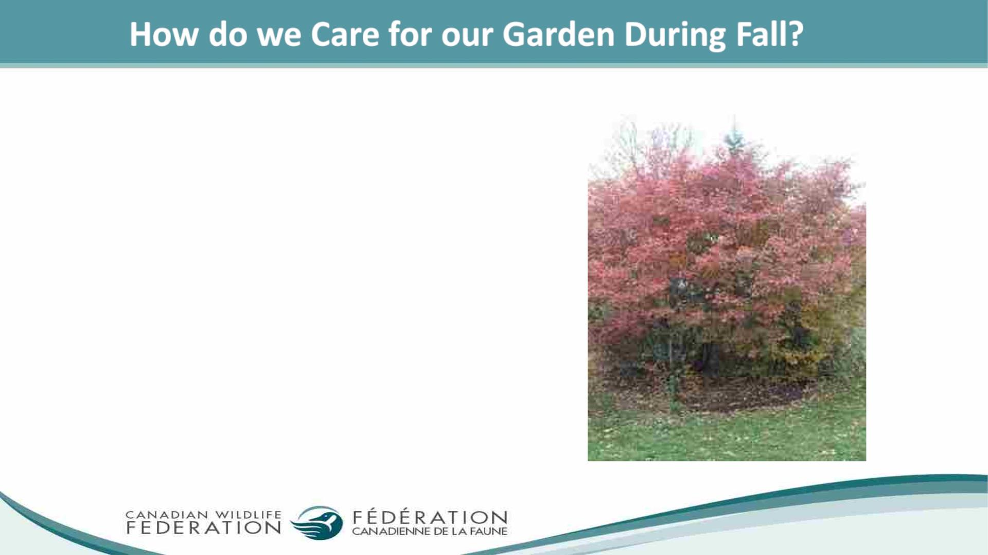
• If you have an excess of leaves that you are
unable to rake under your tree you can chop
them up with your lawn mower and leave the
finely chopped pieces on your lawn for a
natural fertilizer. You can also keep some to
layer in your composter over the winter

Slide 10
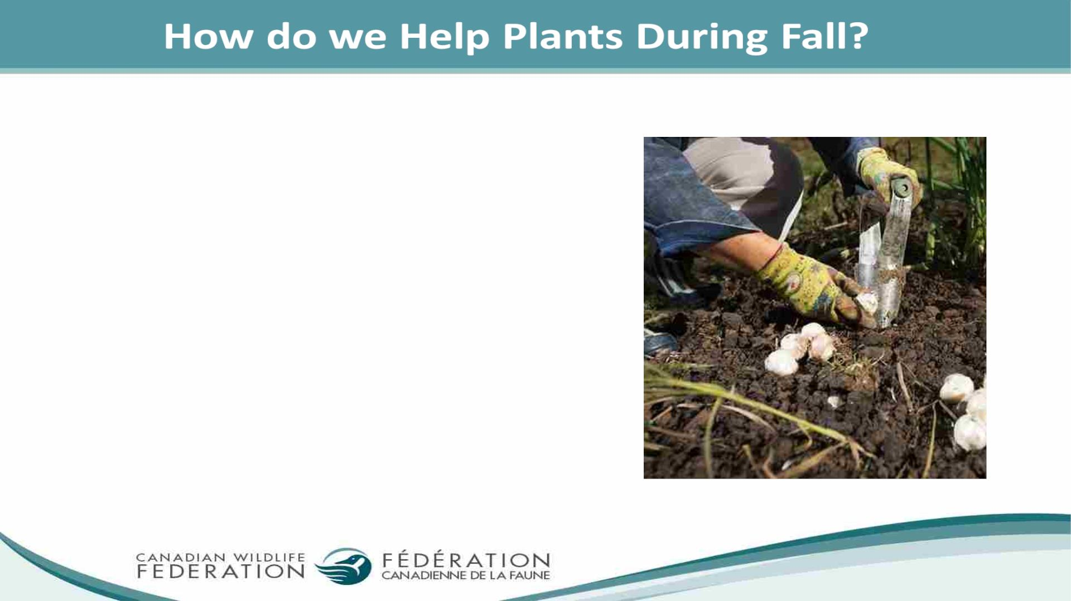
• Some plants need a long period of cool
temperature – dormancy – to stimulate an
early bloom next spring. Planting spring bulbs
such as daffodils, crocuses and hyacinths can
provide nectar and pollen to our insect
pollinators such as – bees, butterflies, flies that
are among the first to be active in the spring
• Plant bulbs a few inches under the soil with the
pointy ends up

Slide 11
Why Plant for Next Spring this Fall?
Other perks for planting in the fall are that the air is cooler, and the soil is wet and warm enough to support the roots of plants before the weather freezes

Slide 12
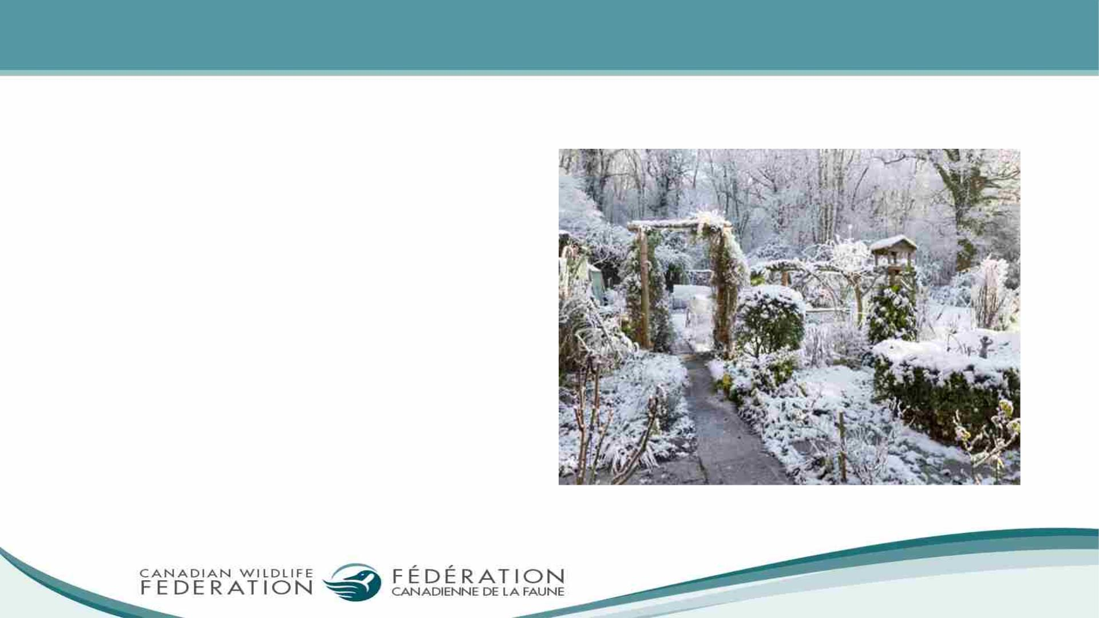
How do we Help our Gardens Before Winter? Part I
• Sometimes winter conditions are just
right for plants. The fast freeze
happens after the insulating snow
has covered your plants. But you
cannot always rely on a mild winter
season or sufficient snow fall. It is
best to protect your plants before
the harsh conditions

Slide 13

Some Suggestions to Help our Plants through the Winter
Here are some suggestions to help your plants
through the winter:
• Potted plants need special care. You can over-
winter them inside. Or you can remove the
plants from their pots and bury them in soil in
your garden
• Some trees and bushes benefit from being
wrapped in burlap. Just like wearing a
snowsuit, the burlap will protect their delicate
branches, buds and needles against the
harmful winds, snow, ice and driving sleet

Slide 14

How do we Help Our Gardens Before Winter? Part II
• For perennial plants that are
susceptible to the cold, you can build
up insulating soil around their base to
protect their roots
• Once the ground is frozen, you can also
take some mulch and place it around
your plants about 15 to 20 centimetres
deep
• The mulch around your trees can also
provide shelter for some pollinators
and small creatures

Slide 15

How do we Help Our Gardens Before Winter? Part III
• Prepare Bird feeders! Support your winter
birds with high oil content untreated seeds
free of pesticides. As you plan new additions
to your garden for next year, keep in mind
plants that will provide a natural source of
food, such as berries, seeds, or nuts year-
round
• For more information, please visit the
following link: Canadian Wildlife Federation:
Get Your Garden Winter-Ready (cwf-fcf.org)

Slide 16

Discussion
1. Why should we care for our school garden in the fall?
2. How can we get our gardens winter-ready?
3. What are some of the fall-blooming plants that
support pollinators?

Slide 17
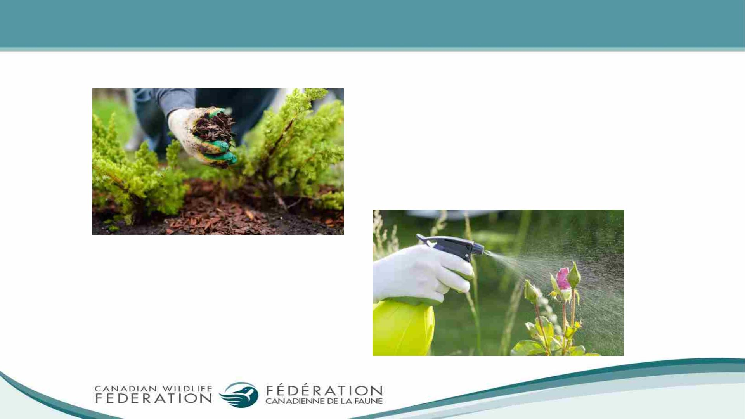
How do we Help Plants? How do we Harm Plants?

Slide 18

Game – Fall Garden Project
Instructions:
• The students will play a game, “Fall Garden Project” in
which they identify which activity is best suited for fall to
prepare their garden for winter and create shelter for
overwintering pollinators
Fall
• The game is to be played in a large space such as a gym or
outside in the yard
• The teacher will designate two spots – True and False far
from each other
Winter

Slide 19
Game – Fall Garden Project Part II
The teacher will write out some questions on small sheets, cut them up and place them in a basket. Each student will walk up to the basket and pick a question for the teacher to read. After the question is read, the students will decide if the activity is appropriate for the fall season by running to the designated spots created

Slide 20

Activity
Goal: To make your garden thrive!
What to include:
• List 3 things you can do to
support plants
• List 1 thing you don't
want to do because it
harms plants

Slide 21
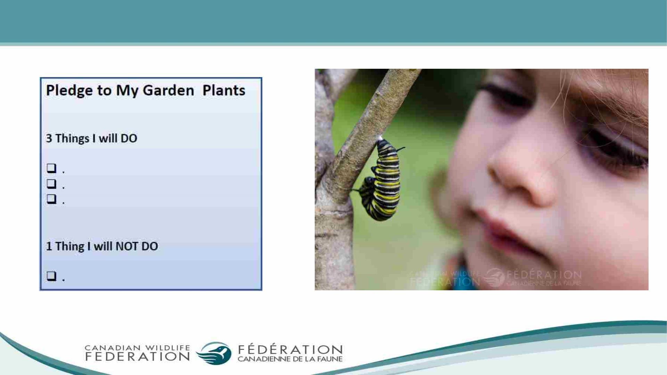
I Can Help the Plants in my Garden

Slide 22
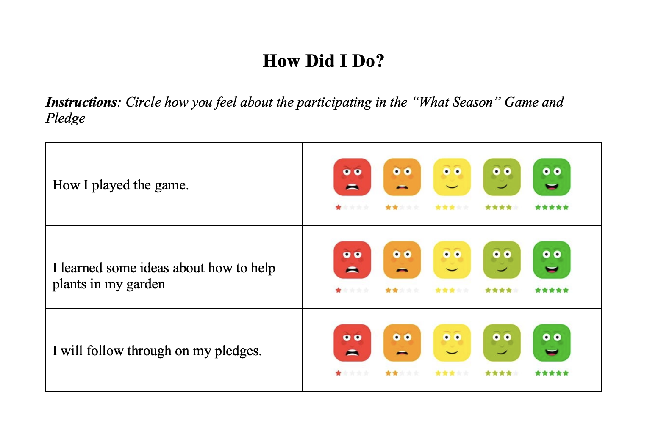
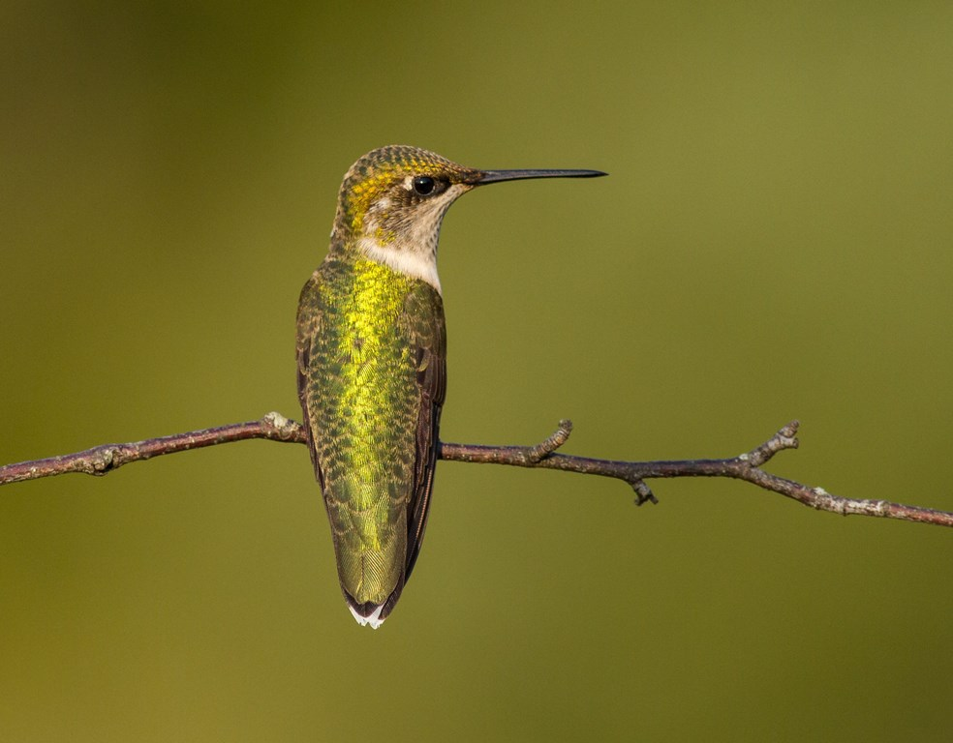
My Thoughts

Slide 23
For more information, please follow this link to
the WILD Spaces online classroom: wildspaces.ca

