Slide 1

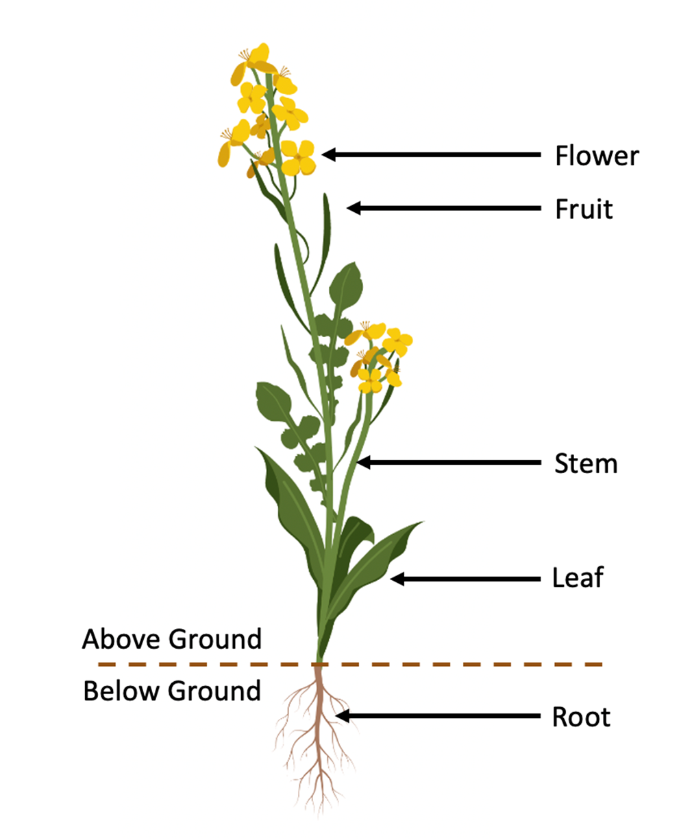
Plant Anatomy
made in ©BioRender - biorender.com
For additional resources visit:
© Canadian Wildlife Federation. All rights reserved. Content may be printed for classroom use only.
CanadianWildlifeFederation.ca/Education

Slide 2
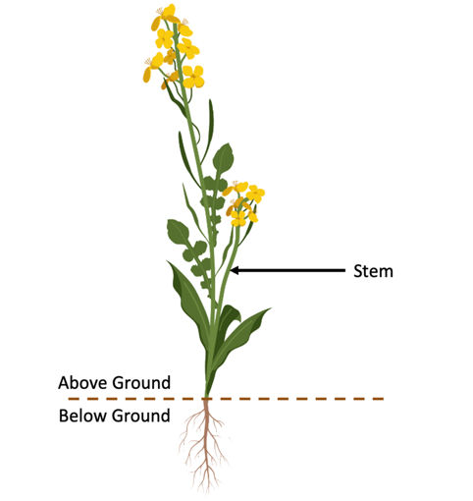
Above Ground Features of a plant
Stem
  Supports the plant
  Holds the buds, leaves, flowers, and fruit
  Facilitates the transportation of nutrients and water from the roots to the leaves and flowers
  Stems may also store food reserves for the plant. Stems can contain few or many branches. Stems are generally located above ground, but there are examples of stems that grow underground. For example: potatoes.
made in ©BioRender - biorender.com
For additional resources visit:
© Canadian Wildlife Federation. All rights reserved. Content may be printed for classroom use only.
CanadianWildlifeFederation.ca/Education

Slide 3
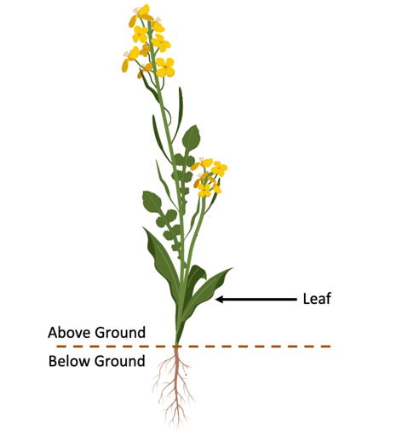
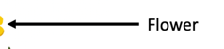
Above Ground Features of a plant
Flower
  A reproductive unit found on angiosperm plants
    Angiosperm plants: another way to say “flowering” plants
  Contains the male and female parts that are involved in the production of seeds
  The parts of a flower will be discussed in the next section.
Leaf
  A flat organ on the plant that attaches to the stem of a plant
    The flat portion of the leaf is called the blade
      This is the main site of photosynthesis
made in ©BioRender - biorender.com
For additional resources visit:
© Canadian Wildlife Federation. All rights reserved. Content may be printed for classroom use only.
CanadianWildlifeFederation.ca/Education

Slide 4
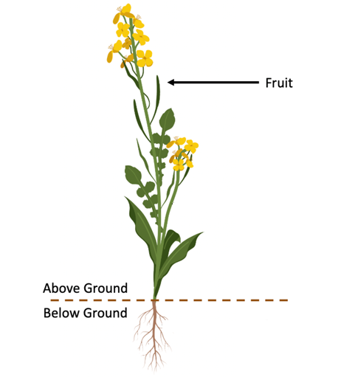
Above Ground Features of a plant
Fruit
  A structure that contains the seeds on a plant
  Following pollination, the plant is able to develop seeds. As those seeds (fruit) mature, their tissue ripens (resulting in colour change, softening, etc.) as they prepare to be deposited into the environment.
  Fruit can be very diverse in shape, colour, and size. Some fruits are dry (e.g. peanuts) and some have fleshy skin that can be eaten (e.g. apples, tomatoes, cucumbers).
made in ©BioRender - biorender.com
For additional resources visit:
© Canadian Wildlife Federation. All rights reserved. Content may be printed for classroom use only.
CanadianWildlifeFederation.ca/Education

Slide 5
Above Ground Features of a plant
Photosynthesis
Photosynthesis is an important process that plants and humans rely on for survival.
During photosynthesis, the plant uses sunlight energy, carbon dioxide, and water to create oxygen and sugar. Sunlight contains photons (energy particles), that can be absorbed by chlorophyll in plant leaves. The energy from the sun is then used to power a chemical reaction inside the leaf tissue. In this chemical reaction, carbon dioxide and water are converted to oxygen and sugar. Photosynthesis gives us the oxygen that we breathe and provides sugar for plants to grow and develop. The chlorophyll pigment in leaves gives plants their green colour.
Energy (sunlight) + carbon dioxide (air) + water (soil) = oxygen (air) + sugar (plant food)
For additional resources visit:
© Canadian Wildlife Federation. All rights reserved. Content may be printed for classroom use only.
CanadianWildlifeFederation.ca/Education

Slide 6
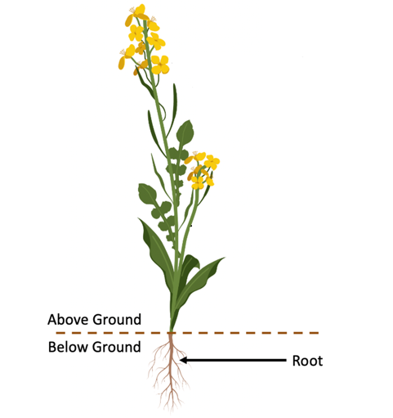
Below Ground Features of a plant
Root
  A network of tissue that anchors the plant into the environment (typically the soil)
  Also a means for nutrient and water uptake from the soil (a crucial role!)
    Nutrients and water absorb in the roots and are transported to other important plant tissues
There are two major types of roots:
  Tap roots have a large, central primary root (e.g. a carrot).
  Fibrous roots are small, highly branched root systems (commonly found in native grass plants).
made in ©BioRender - biorender.com
For additional resources visit:
© Canadian Wildlife Federation. All rights reserved. Content may be printed for classroom use only.
CanadianWildlifeFederation.ca/Education

Slide 7
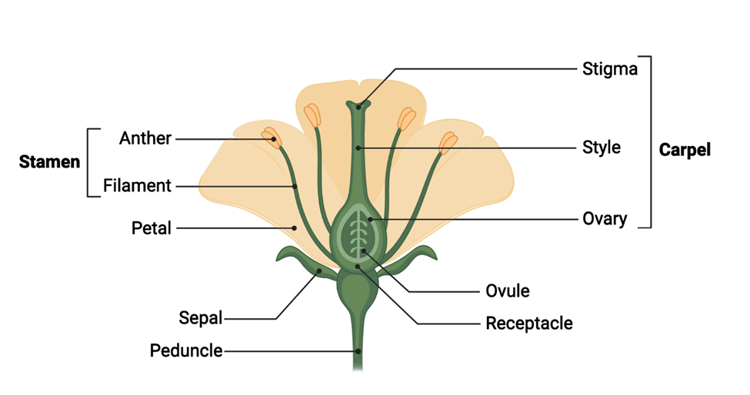
PARTS OF A FLOWER
made in ©BioRender - biorender.com
For additional resources visit:
© Canadian Wildlife Federation. All rights reserved. Content may be printed for classroom use only.
CanadianWildlifeFederation.ca/Education

Slide 8
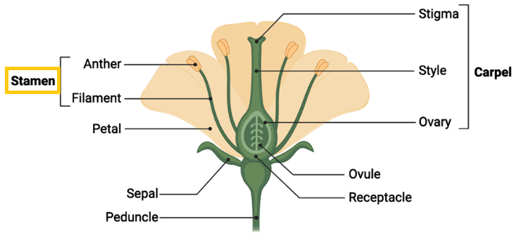
Male parts of a flower
Stamen
  Responsible for the production of pollen
  Includes the anther and the filament tissue
  Can be different colours
  Play an important role in the attraction of pollinators
made in ©BioRender - biorender.com
For additional resources visit:
© Canadian Wildlife Federation. All rights reserved. Content may be printed for classroom use only.
CanadianWildlifeFederation.ca/Education

Slide 9
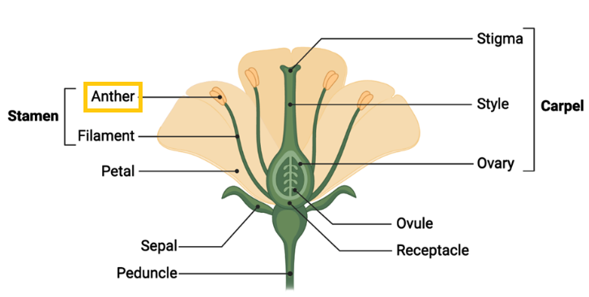
Male parts of a flower
Anther
  Tissue that produces pollen
  A small sac-like structure where pollen grains develop
made in ©BioRender - biorender.com
  When the plant enters the flowering period, the anther breaks open and spreads pollen grains to the environment. When pollinators interact with the flower, pollen from the anther can be transferred onto the surface of a pollinator and transferred to other plants.
For additional resources visit:
© Canadian Wildlife Federation. All rights reserved. Content may be printed for classroom use only.
CanadianWildlifeFederation.ca/Education

Slide 10
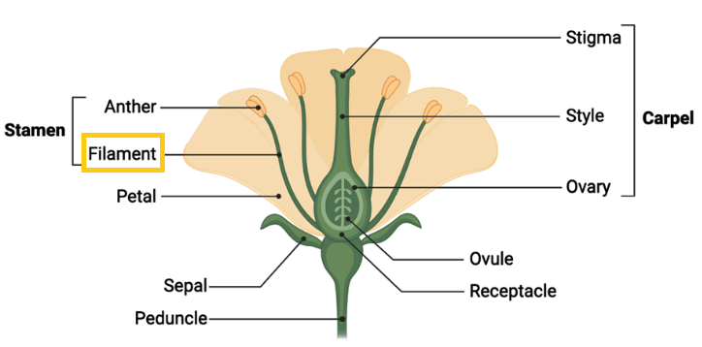
Male parts of a flower
Filament
  A long slender stalk that connects the anther to the base of the flower
  Can be long or short, depending on the plant species
made in ©BioRender - biorender.com
For additional resources visit:
© Canadian Wildlife Federation. All rights reserved. Content may be printed for classroom use only.
CanadianWildlifeFederation.ca/Education

Slide 11
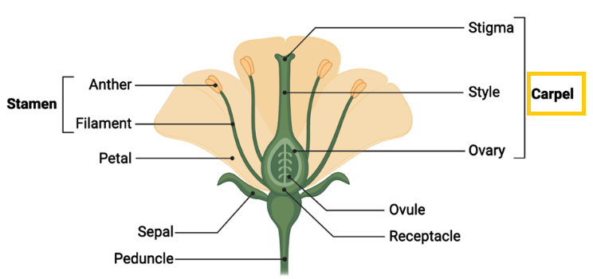
Female parts of a flower
Carpel
  The basic reproductive unit of the plant
  Includes the stigma, style, and the ovary
  Can also be referred to as pistils
made in ©BioRender - biorender.com
For additional resources visit:
© Canadian Wildlife Federation. All rights reserved. Content may be printed for classroom use only.
CanadianWildlifeFederation.ca/Education

Slide 12
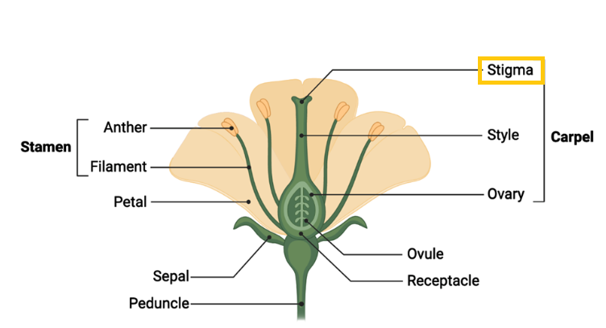
Female parts of a flower
Stigma
  Located at the top part of the carpel. Receives pollen
  Pollen can be transferred from the pollinator onto the stigma. Once pollen lands on the stigma, water enters the pollen grain. The pollen grain becomes hydrated and establishes a strong connection to the stigma.
made in ©BioRender - biorender.com
  The pollen grain can then form a pollen tube which transports the male cells through the female organ.
  When the pollen tube reaches the ovule, fertilization can occur, which forms a seed.
For additional resources visit:
© Canadian Wildlife Federation. All rights reserved. Content may be printed for classroom use only.
CanadianWildlifeFederation.ca/Education

Slide 13
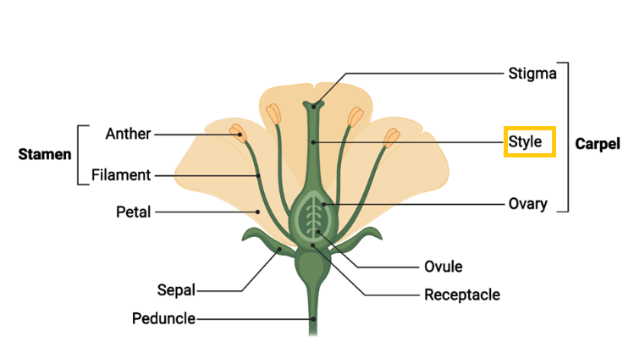
Female parts of a flower
Style
A long slender region located between the stigma and the ovary.
made in ©BioRender - biorender.com
For additional resources visit:
© Canadian Wildlife Federation. All rights reserved. Content may be printed for classroom use only.
CanadianWildlifeFederation.ca/Education

Slide 14
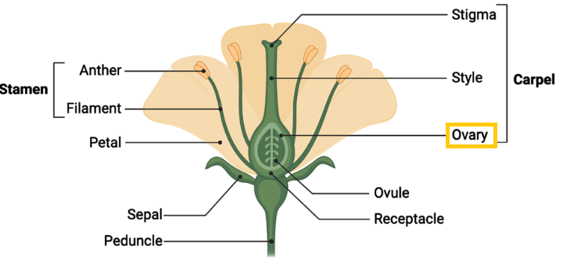
Female parts of a flower
Ovary
  Located at the base of the female reproductive unit
  Houses the ovules (eggs) that are critical for the production of new seeds
made in ©BioRender - biorender.com
  Following successful pollination, the ovary will develop into fruit. The fruit protects the developing seeds from damage. The fruit can be eaten by humans and animals, which helps spread seeds into the environment.
For additional resources visit:
© Canadian Wildlife Federation. All rights reserved. Content may be printed for classroom use only.
CanadianWildlifeFederation.ca/Education

Slide 15
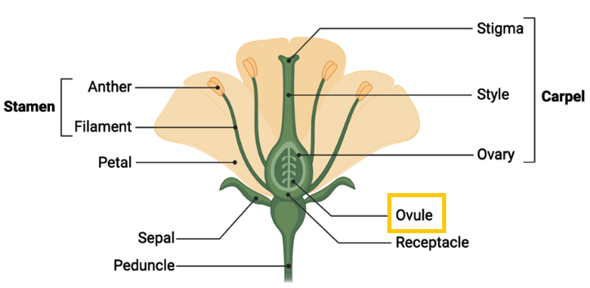
Female parts of a flower
Ovule
  Located inside the ovary
  Contains the female eggs
  The eggs are fertilized by cells contained inside the pollen, which gives rise to new seeds.
made in ©BioRender - biorender.com
For additional resources visit:
© Canadian Wildlife Federation. All rights reserved. Content may be printed for classroom use only.
CanadianWildlifeFederation.ca/Education

Slide 16
Other important features of flowers
Sepal
  Forms the protective barrier surrounding the developing, unopened flower bud
  When the flower blooms (opens), the sepals and petals emerge from the flower bud. The open flower exposes the reproductive structures and allows for processes like pollination to occur.
made in ©BioRender - biorender.com
Petal
Nectaries
  A modified leaf that surrounds the reproductive parts of the flower
  Can have a wide spectrum of colour
  Plays a major role in the attraction of pollinators
  The petals influence the shape of the flower, which can also influence the types of pollinators that interact with a flower.
  Regions on the flower that contain nectar
    Nectar is a sugar-rich liquid produced by plants.
    Nectar attracts pollinators by providing a source of food.
  Are found on different flower parts depending on the species of plants
  Often located on the stamens, filaments, pistils (carpels), and petals
For additional resources visit:
© Canadian Wildlife Federation. All rights reserved. Content may be printed for classroom use only.
CanadianWildlifeFederation.ca/Education

Slide 17
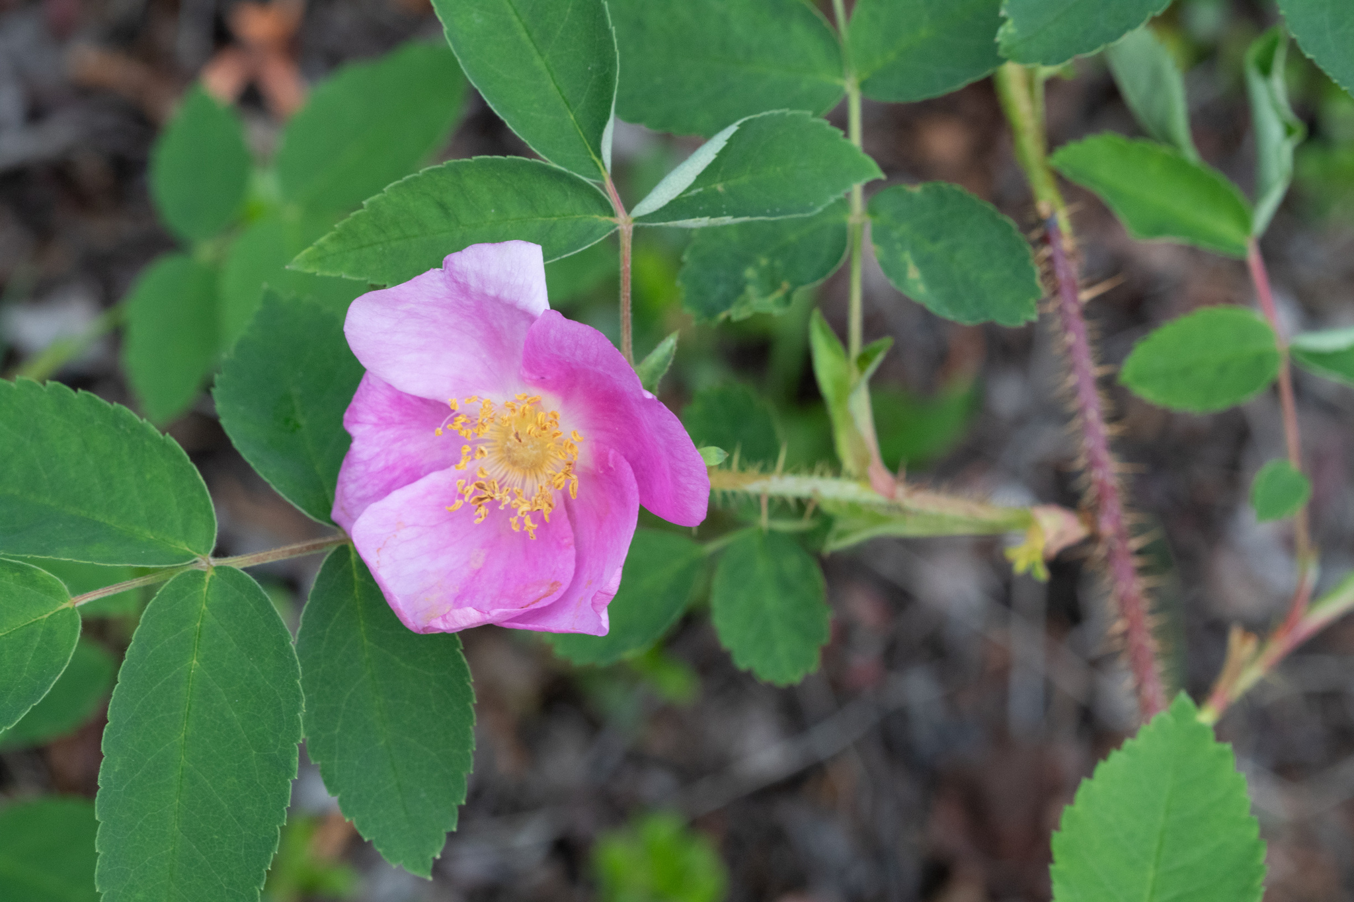
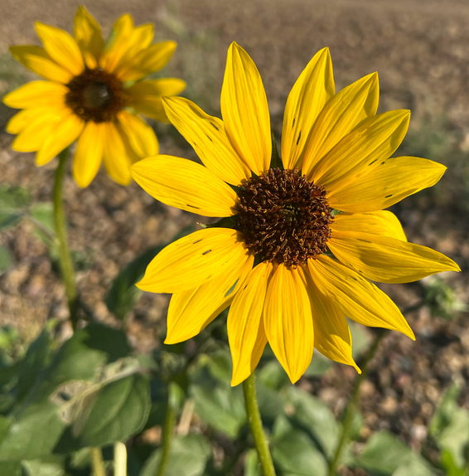
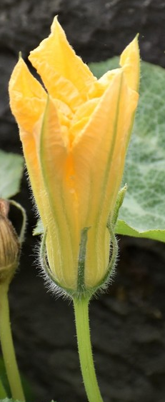
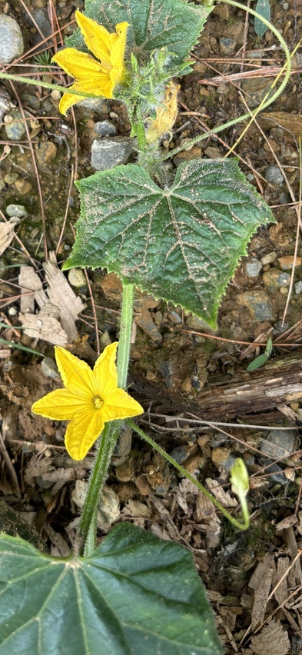
Types of Flowers
Perfect Flowers
Prickly Wild Rose
Common Sunflower
Perfect flowers contain both male and female parts on the same flower. Examples of perfect flowers are prickly roses and sunflowers.
Photo by iNat user Jukkajantunen
Photo by iNat User jasonalexander
Squash
Cucumber
Imperfect Flowers
Imperfect flowers are missing either male or female parts. This means that plants would have separate male and female flowers. Examples of plants with imperfect flowers are squash, cucumber, and Canadian holly.
Photo by iNat
User PineMartyn
Photo by iNat
User Sandwich
For additional resources visit:
© Canadian Wildlife Federation. All rights reserved. Content may be printed for classroom use only.
CanadianWildlifeFederation.ca/Education

Slide 18
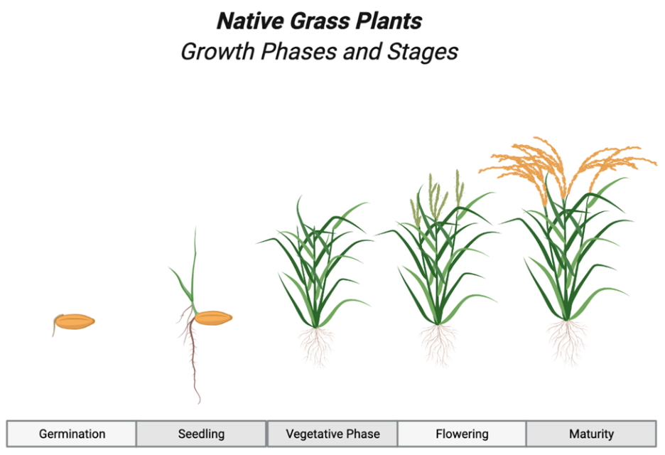
Life Cycle of Plants
made in ©BioRender - biorender.com
For additional resources visit:
© Canadian Wildlife Federation. All rights reserved. Content may be printed for classroom use only.
CanadianWildlifeFederation.ca/Education

Slide 19
Life Cycle of a Plant
Germination
  After seeds are planted in their environment, they require a few important resources to germinate: the correct temperature, oxygen, and water.
  Inside of the seed, the baby plant (embryo) will start to grow using the resources contained within the seed. These resources include starches, sugar, and protein.
  As the baby plant grows, it becomes able to break through the seed coat and start growing in the soil. The small plant has a root growing down in the soil. The cotyledons (seed leaves) push through the soil in order to seek sunlight.
  Once the small plant breaks through the soil and is exposed to the sunlight, it can start to produce its own energy through photosynthesis.
made in ©BioRender - biorender.com
For additional resources visit:
© Canadian Wildlife Federation. All rights reserved. Content may be printed for classroom use only.
CanadianWildlifeFederation.ca/Education

Slide 20
Life Cycle of a Plant
Seedling
  During the seedling phase, the plant will start to develop mature leaves.
  The original leaves present on the small plant when it broke through the soil were called cotyledons (also known as seed leaves).
  The new mature leaves can often have a different appearance from the cotyledons. The mature leaf tissue will have high levels of photosynthesis occurring. This will allow the plants to grow more rapidly and increase in size.
made in ©BioRender - biorender.com
For additional resources visit:
© Canadian Wildlife Federation. All rights reserved. Content may be printed for classroom use only.
CanadianWildlifeFederation.ca/Education

Slide 21
Life Cycle of a Plant
Vegetative Phase
  During the vegetative stage, the plant continues to increase the production of biomass and leaves. The vegetative stage is critical to ensure plants have enough energy and nutrients before transitioning to the flowering phase.
  During the late stages of the vegetative phase, flower buds will start to emerge on the plant.
made in ©BioRender - biorender.com
For additional resources visit:
© Canadian Wildlife Federation. All rights reserved. Content may be printed for classroom use only.
CanadianWildlifeFederation.ca/Education

Slide 22
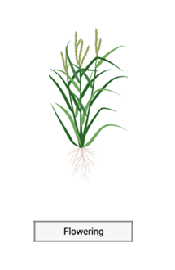
Life Cycle of a Plant
Flowering Phase
The flowering stage in plants requires an abundance of energy and nutrients. During the flowering stage, the plants produce flower buds that eventually develop into mature flowers. When the flowers are ready for reproduction, they bloom. During flowering, pollinators are able to interact with the male and female parts located on the flower.
made in ©BioRender - biorender.com
For additional resources visit:
© Canadian Wildlife Federation. All rights reserved. Content may be printed for classroom use only.
CanadianWildlifeFederation.ca/Education

Slide 23
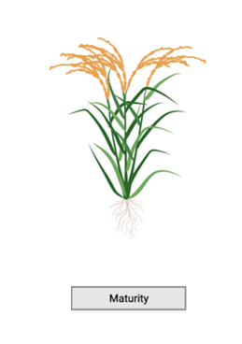
Life Cycle of a Plant
Maturity
  As the life cycle of the plant comes to an end, the plant must first go through the maturation phase.
  During this period, nutrients stored in the plant tissue can be moved to the seed tissue. The seeds will need this energy to undergo germination.
  During the maturity phase, the seeds finish development and are ready to be spread into the environment.
made in ©BioRender - biorender.com
For additional resources visit:
© Canadian Wildlife Federation. All rights reserved. Content may be printed for classroom use only.
CanadianWildlifeFederation.ca/Education

Slide 24
Life Cycle Complete
For additional resources visit:
© Canadian Wildlife Federation. All rights reserved. Content may be printed for classroom use only.
CanadianWildlifeFederation.ca/Education

